Slide 1
Report Analysis of Car Theft (2005-2023)
INDIA
An Analysis of Car Theft Trends, Recovery Rate and Insights

Slide 2
Table of contents
01
02
03
Introduction
Theft Trends
Overview of the analysis and dataset
Analysis of theft incidents over time
Recovery Insights
Stolen Vehicles Analysis
04
Impact of GPS, recovery rates, and effectiveness
Brands, Models, and fuel types targeted
CONCLUSION
05
Preventive measures and policy suggestions

Slide 3
01
INTRODUCTION
Overview of the analysis and dataset

Slide 4
Introduction
Car theft remains a significant challenge in India, affecting individuals, businesses, and law enforcement agencies. This report provides an in-depth analysis of car theft incidents across the country in 2023. By examining trends, hotspots, and recovery rates, we aim to identify patterns that can help in formulating effective preventive measures. The analysis is based on a dataset covering 10,000 car theft cases, highlighting key
factors such as the most targeted car brands, theft trends over time, geographical distribution, and the impact of anti-theft technologies like GPS tracking. This report will help stakeholders, including law enforcement agencies, policymakers, and vehicle owners, to understand car theft dynamics and implement strategies to reduce crime rates and improve vehicle recovery efforts.

Slide 5
02
THEFTS TREND
Analysis of theft incidents over time

Slide 6
Thefts Trend
Analyzing car theft trends over time helps identify patterns and predict future risks. The data reveals this key insights:
Theft Over the Years
Theft by Brand and Fuel-Type
Theft by States
In light of these insights, data-driven recommendations believed to reduce and prevent high-risks incidents are mentioned.

Slide 7
Theft Trends Over the Years
INSIGHTS
The highest number of stolen vehicles were manufactured between 2014 and 2017 with an average of 500 vehicles per years, suggesting older models are more vulnerable.
A decline in thefts for newer models (post-2018), indicates improved vehicle security features.
RECOMMENDATIONS
Encourage owners of older vehicles to install modern anti-theft devices (GPS trackers, alarm systems)
Vehicle owners should be educated on safe parking practices such as using secure garages
Newer models with keyless entry should adopt motion-sensing key fobs to prevent hacking

Slide 8
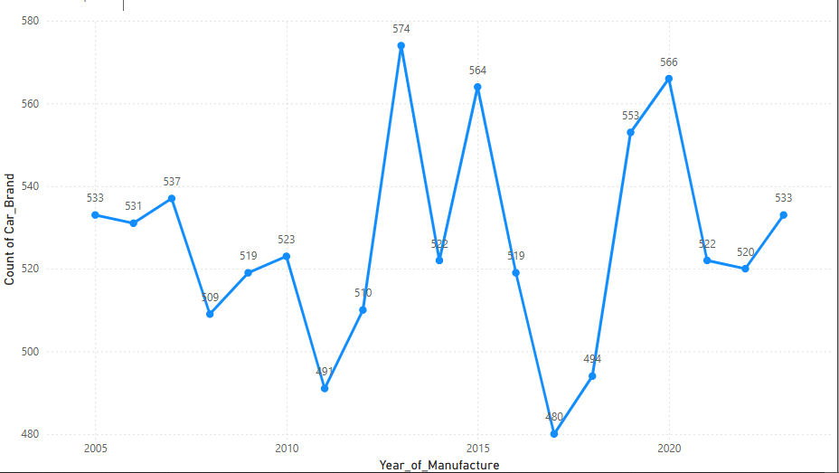
Fig 1: Thefts Trends Over the Years

Slide 9
Theft Trends by Brands and Fuel-Type
INSIGHTS
Thefts is fairly distributed among different brands, but Toyota, Hyundai, Honda, and Maruti have higher theft rates which can be due to high market demand for resale value and parts.
Petrol and Diesel cars have higher theft numbers compared to CNG and Electric Cars
Electric Vehicles (EVs) have lower theft rates, possibly due to GPS tracking features
RECOMMENDATIONS
Owners of frequently stolen brands should install advanced security features (GPS trackers).
Since petrol and diesel cars are stolen more often, owners should be encouraged to park in secured locations.
GPS tracking should be promoted across all fuel types, including CNG and Diesel models, to improve the chances of vehicle recovery

Slide 10
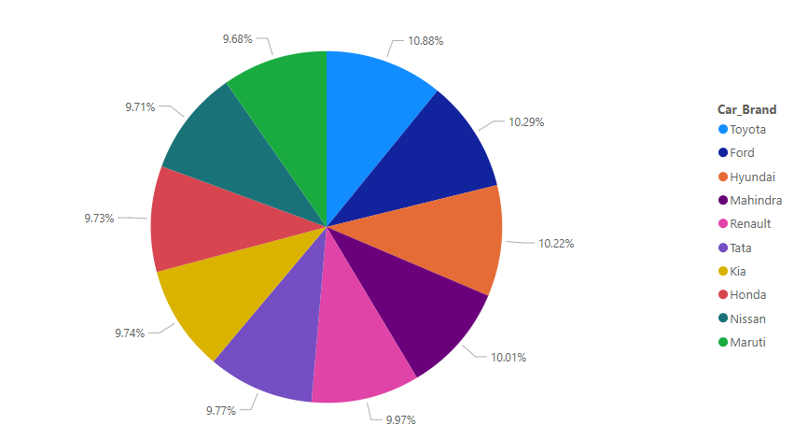
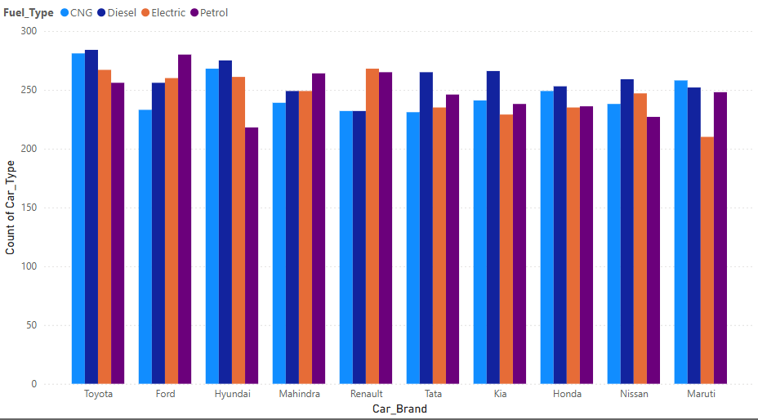
Fig 1: Thefts Trends By Brands
Fig 2: Thefts Trends By Brands and Fuel Type

Slide 11
Theft Trends by States
INSIGHTS
Gujarat, Rajasthan, Maharashtra have the highest car theft incidents, making them high-risk zones
Theft rates are significantly higher in urban cities likely due to higher vehicle density and anonymity in large crowds.
RECOMMENDATIONS
Increase police patrols in high-risk areas, such as parking lots, highways and densely populated urban centers
Encourage the mandatory installation of GPS trackers in newly registered vehicles in high-theft states.
Run awareness campaign in Gujarat, Rajasthan, Maharashtra about theft risks and prevention measures.

Slide 12
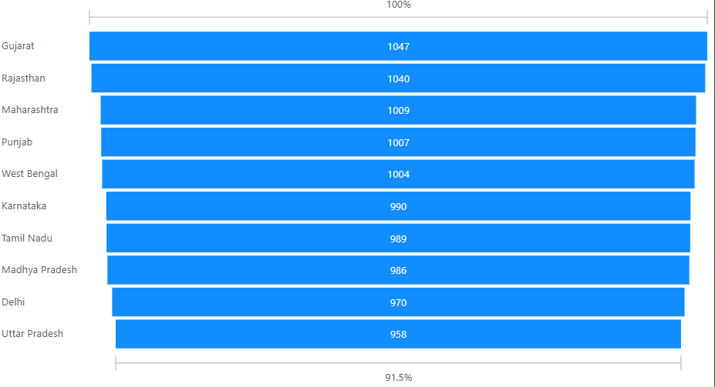
Fig 1: Thefts Trends by State

Slide 13
03
STOLEN VEHICLES ANALYSIS
Analysis about stolen vehicles over time

Slide 14
STOLEN VEHICLE ANALYSIS
The total numbers of stolen vehicles report from (2005-2023) across India is 10000 vehicles.
Only 3041 vehicles (30.4%) were recovered, leaving 6959 unrecovered, indicating a challenge in tracking stolen cars.
Older vehicles between 2013-2017 are more vulnerable to being stolen.
Urban areas experience more thefts due to higher vehicle density and ease of movement for criminals.

Slide 15
04
RECOVERY INSIGHTS
Impact of GPS, recovery rates, and effectiveness

Slide 16
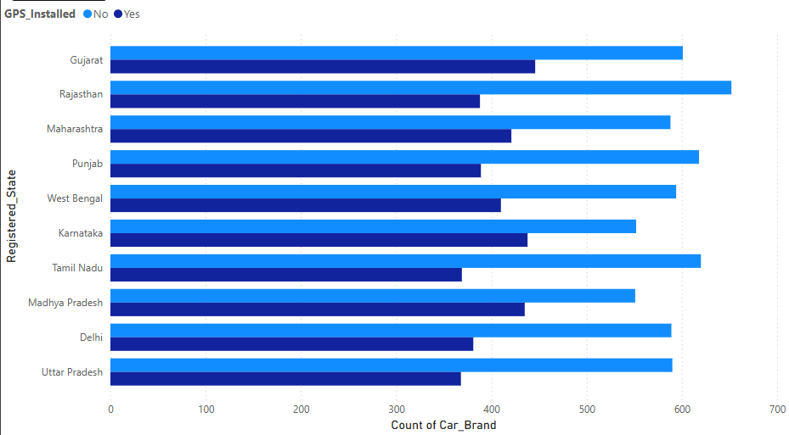
Display concepts visually
Insight
Recommendation
Insight
Recommendation
69.6% vehicles remain unrecovered
Encourage GPS installation in all vehicles
Non GPS vehicles are less frequently recovered
Increase awareness about theft prevention
Fig 1: Cars Recovered based on GPS installation

Slide 17
05
CONCLUSION
Preventive measure and policy suggestions

Slide 18
Conclusion
Encourage vehicle owners to install GPS trackers and advanced security measures
Strenthen law enforment efforts in high-theft regions
Improve public awareness on theft prevention and secure parking habits

Slide 19
Thanks!
Do you have any questions?
ayodejiakinwunmi25@gmail.com
+234 916 094 5171

